Slide 1

Lightweight SQL Data Access with Dapper
Mattias Karlsson Senior Consultant - WCOM AB
2013-01-30

Slide 2
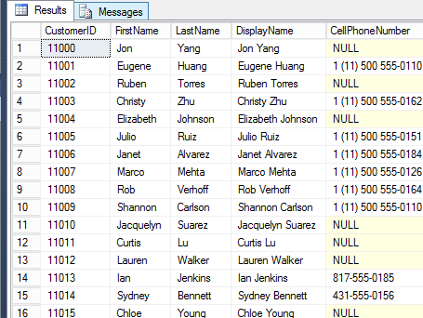

Dapper - a simplistic data to object mapper (ORM) for .Net
public class Customer
{
public long CustomerId { get; set; }
public string FirstName { get; set; }
public string LastName { get; set; }
public string DisplayName { get; set; }
public string CellPhoneNumber { get; set; }
public string WorkPhoneNumber { get; set; }
public string HomePhoneNumber { get; set; }
public string EmailAddress { get; set; }
public string Password { get; set; }
public DateTime? ModifiedDate { get; set; }
public DateTime Created { get; set; }
}

Slide 3

Micro ORM vs. Traditional ORM
Micro ORM
Traditional ORM

Slide 4

Micro ORM vs. Traditional ORM
Micro ORM
Traditional ORM
MVC
WEB FORM

Slide 5

Dapper - History
Created by Sam Saffron about 2 years ago while working at Stack Exchange (Stack Overflow)
Open Sourced and published April 2011 at Google Code
Shortly after also published at GitHub

Slide 6
Dapper – Why?
Performance issues at Stack Overflow
Web servers often 100% CPU
Slow page rendering while Google/Bot indexing
Profiling pointed at Linq2Sql

Slide 7
Dapper – Why?
Performance issues at Stack Overflow
Web servers often 100% CPU
Slow page rendering while Google/Bot indexing
Profiling pointed at Linq2Sql
Initial tests cost of pulling out 100 random posts
Hand coded 164ms
Sams ORM 174ms
LINQ 2 SQL ExecuteQuery 242ms
LINQ 2 SQL 335ms
Entity Framework 4.1 550ms

Slide 8
Dapper – Why?
Performance issues at Stack Overflow
Web servers often 100% CPU
Slow page rendering while Google/Bot indexing
Profiling pointed at Linq2Sql
Performance of SELECT mapping over 500 iterations
Hand coded (using a SqlDataReader) 47ms
Dapper ExecuteMapperQuery 49ms
ServiceStack.OrmLite (QueryById) 50ms
PetaPoco 52ms
BLToolkit 80ms
SubSonic CodingHorror 107ms
NHibernate SQL 104ms
Linq 2 SQL ExecuteQuery 181ms
Entity framework ExecuteStoreQuery 631ms

Slide 9
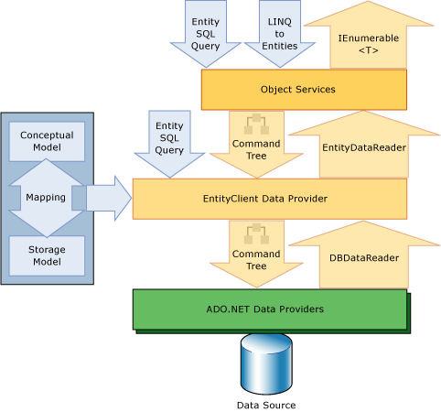
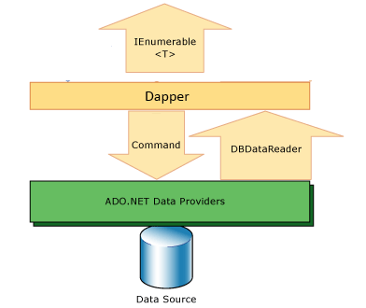
Architecture Dapper vs. EF
Dapper
Entity Framework

Slide 10

Demo.001
HELLO WORLD

Slide 11
Demo.001 – Hello World
IEnumerable<T> Query<T>(this IDbConnection cnn, string sql, …)
Extends ADO.Net IDbConnection supports most .Net data providers
SqlConnection
OdbcConnection
OleDbConnection
OracleConnection
MySqlConnection
EntityConnection
Etc…

Slide 12
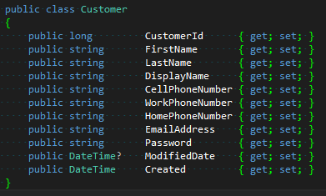
Demo.002
POCO - Plain Old CLR Object

Slide 13
Demo.002 – Poco
Query<Customer>(this IDbConnection cnn, string sql, …)
Execute a query and map the results to a strongly typed List
Dapper executes query
Generates IL for serialization
Compiles to delegate
Caches delegate based on query (and parameters if specified)
2:nd execution cached and compiled delegate almost as fast as hand coded

Slide 14
Demo.003
My momma always said, dynamically typed languages are like a box of chocolates, you never now what your gonna get
DYNAMIC

Slide 15
Demo.003 – Dynamic
Query<dynamic>(this IDbConnection cnn, string sql, …)
Execute a query and map the results to a list of dynamic objects
Execute query
Field definitions cached per query

Slide 16

Demo.004
PARAMETERS

Slide 17
Demo.004 – Parameters
Query<Customer>(this IDbConnection cnn, string sql, dynamic param …)
Execute a query with parameters
Typed
Named
Injection safe

Slide 18
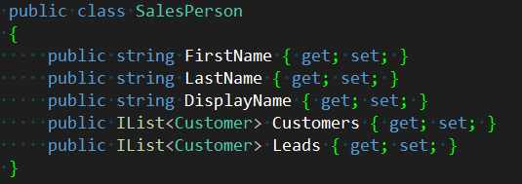
Demo.005
Query MultiplE

Slide 19
Demo.005 – Query Multiple
GridReader QueryMultiple(this IDbConnection cnn, string sql, dynamic param …)
Execute a query with multiple results
One query/connection – Multiple results
Static or Dynamic typing
Deferred loading

Slide 20
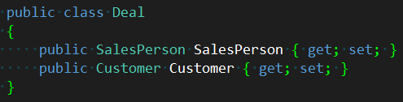
Demo.006
Multi Mapping

Slide 21
Demo.006 – Multi Mapping
Query<Customer, SalesPerson, Deal>(this IDbConnection cnn, string sql, dynamic param , string splitOn …)
Execute a query where each row is mapped to multiple objects
1 to 1 joins reduce number of queries
Cached/Typed serialization

Slide 22
Addons / Helpers
Dapper Contrib
https://github.com/SamSaffron/dapper-dot-net/tree/master/Dapper.Contrib
Dapper Async
http://nuget.org/packages/Dapper-Async
Dapper Extensions
http://nuget.org/packages/DapperExtensions/
StackOverflow
http://stackoverflow.com/questions/tagged/dapper

Slide 23
Resources
GitHub
https://github.com/WcomInfo
https://github.com/SamSaffron/dapper-dot-net
NuGet
PM> Install-Package Dapper
https://nuget.org/packages/Dapper/
StackOverflow
http://stackoverflow.com/questions/tagged/dapper

Slide 24
Mattias Karlsson Senior Consultant - WCOM AB
matkar@wcom.se

